Slide 1

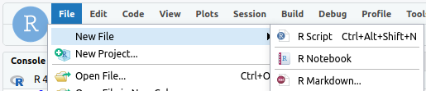


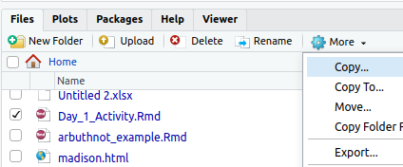



MTH142 Intro to Stats:: CHEAT SHEET
Getting started
Screen Shots
Libraries
View Data Sets
Signing into RStudio
Mac: Shift + Command + 3
library(openintro)
library(tidyverse)
library(broom)
cars93 is the data set
glimpse(data = cars93)
head(cars93)
First six rows (tail() works too)
view(cars93)
makes window for all data
names(cars93)
show variable names only
http://hcc-rstudiosrv1.hcc.edu:8787/
Windows: + Shift + S
Chromebook: Shift + Ctrl +
To get more info on a dataset,
load a library then use ?
library(openintro)
?cars93
Username: Your HCC email with @hcc.edu
Password: Your HCC password
.Rmd files
Summary Statistics
Graphs
Variables
box plots
ggplot(data = cars93,
mapping = aes(x = weight, fill = type)) +
geom_boxplot()
histograms
ggplot( cars93, aes(x = weight)) +
geom_histogram()
bar
ggplot(cars93, aex(x= type )) +
geom_bar()
scatter plots
ggplot(data=cars93, aes(x = weight, y = mpg_city)) +
geom_point()+
geom_smooth(method = "lm", se=FALSE)
titles and labels
New .rmd File>New File>R Markdown...
fivenum(cars93$price)
Just the five number summary
summary(cars93)
summarizes all the variables
tally(cars93)
counts the observations
mean(cars93$weight, na.rm = TRUE)
calculates the mean of the weights
and removes missing values.
sd(cars93$weight)
a_variable <- c(1,2,3)
takes the vector 1,2,3 and
saves it as a variable with the
assignment operator
Uploading a file Lower Right quadrant click upload
Math Type
Knitting a file click the knit button and save.
Use $$ to enclose math type.
$\mu$ $\sigma$
$\bar{x}$ $\hat{p}$
$H_o$ $\alpha$
$\ne$ $\approx.$
$\sim$
Confidence Intervals
Exporting a file select file in lower right quadrant click more then Export…
List of Standard Error formulas
For a mean from a vector of data
t.test(cars93$weight)
produces a 95% confidence interval for the mean
weights of cars sold in 1993.
For a proportion from Statistics
prop.test(x = 20, n = 60, conf.level=0.90,correct=FALSE)
produces a 90% confidence interval for the population
proportion given 20 successes in 60 trials.
For mean use formula below
For the confidence interval of the mean from statistics we use the
following formula:
SE for a single proportion
SE for a single mean or paired means.
SE for two means (not paired)
CC BY SA Nic Schwab • nschwab@hcc.edu • Updated: Aug 17, 2024

Slide 2
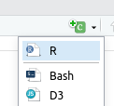
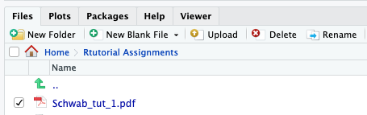
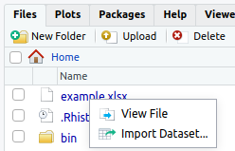
MTH142 Intro to Stats:: CHEAT SHEET
R Markdown cont.
normal distribution
student t distribution
New chunk click the green c+ and select r
pt(1,df=11, lower.tail = FALSE)
outputs the p-value if t = 1 and 11 degrees of freedom on the upper tail of the distribution
qt(0.01,df=11)
outputs the t-score if probability = 0.01
Pnorm( q= 1, mean=0 ,sd=1)
Outputs the probability if z=1 from a standard normal dist.
qnorm(p = 0.01,mean=0, sd=1)
Outputs the z-score if probability=0.01
T
help
Rename a file
Click the box next to the file and chose rename.
simulation
Hypothesis Tests
library(infer)
# 1. Make a vector to mimic data
more_than_1_relationship <- c(
rep(TRUE, 152),
rep(FALSE, 51)
)
# 2. change the vector to a data frame
more_than_1_relationship <- as.data.frame(more_than_1_relationship)
# 3 run infer chain
set.seed(2024)
null_distn_one_prop <- more_than_1_relationship |>
specify(response = more_than_1_relationship, success = "TRUE") |>
hypothesize(null = "point", p = 0.5) |>
generate(reps = 10000, type = "draw") |>
calculate(stat = "prop")
# 4 Take a look at the distribution
visualise(data = null_distn_one_prop)
get_p_value(x = null_distn_one_prop,
obs_stat = 0.749,
direction = 'greater')
Uploading Data
1. Copy and paste data into a spreadsheet.
2. Variables are column headers (no spaces in variable name)
3. Save as an .xls file to your computer (no spaces in file names)
4. Upload .xls file
5. Click on the file you uploaded > Import Dataset
Proportions
prop.test(x=20, n=60, p=0.5, correct=FALSE)
Outputs the results of hypothesis test with 20 successes in 60 trials
Single Mean
t.test(cars93$weight, mu=2000, alternative="g")
Outputs of a right tailed hypothesis test with parameter mu=2000.
Difference of Means
t.test(time_hrs~division,data=nyc_marathon, alternative="t")
Computes the difference of men and women winning times in NYC marathon
ANOVA
cars_anova<-aov(weight~type,data=cars93)
performs the analysis of variance and saves it as a variable “cars_anova”
anova(cars_anova)
outputs the summary of the analysis
Linear Regression
cars_linear<-lm(price~weight,data=cars93)
performs the linear regression and saves it as a variable “cars_linear”
summary(cars_linear)
outputs the linear summary of the regression
CC BY SA Nic Schwab • nschwab@hcc.edu • Updated: Aug 17, 2024

